Slide 1
Broadcast Technology UG1
9: DVB, Compression Intro, TS, PS
Jerry Foss
jeremy.foss@bcu.ac.uk
DVB, COMPRESSION INTRO, TS, PS:
DVB
MPEG compression (Intro)
PS,TS, Streaming
IP Workflows

Slide 2
This Session:
Networks
TDM
Circuit Switching
Packet Switching
Layers of Networks
Telephone, Internet, WWW
MPEG Systems
Multiplexes
Program Streams
Transport Streams
Statistical Multiplexing
DVB
Streaming
HTTP
ABR, DASH
SDI and IP
SMPTE 2022, 2110

Slide 3
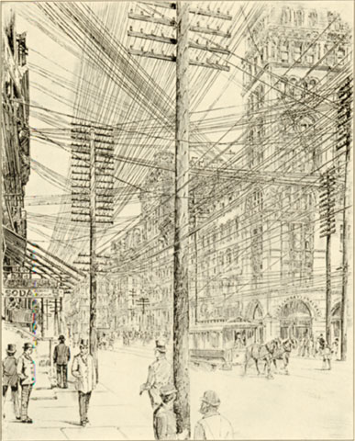
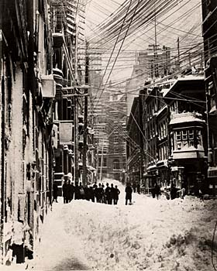
From Circuits …
… to Packets

Slide 4
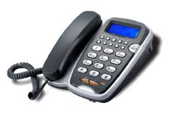
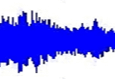
Traditional PSTN - Digitisation of the Network
Digital Network
Traditional 4KHz channels
... digitized to 8bit 64kb/s channels
10110011
10110011
Local Exchange
Trunk / Transit
Exchanges

Slide 5
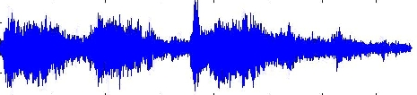
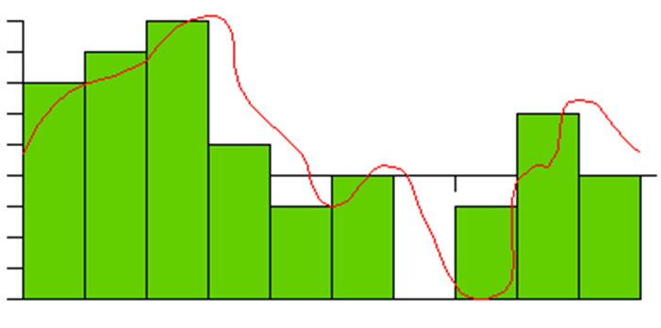
Time Division Multiplex
amplitude
4kHz voice
sampled at 8kHz
into 8 bits binary
time
10110011
10010001
01010010
amplitude
time

Slide 6
Time Division Multiplex
Many phone calls at the same time allocated to other slots in the multiplex
Analogue – Digital: Samples are dropped into allocated timeslot for each frame
TS6 next frame
TS6 previous frame
TS6 this frame
010100101
010100101
01001001
10010001
01010010
010100101
10010001
01001001
010100101
010100101
01001001
TS1 TS2 TS3 TS4 TS5 TS6 TS7 TS8 ………………………………………………………………….
30 channels of speech into a time-divided-multiplex

Slide 7
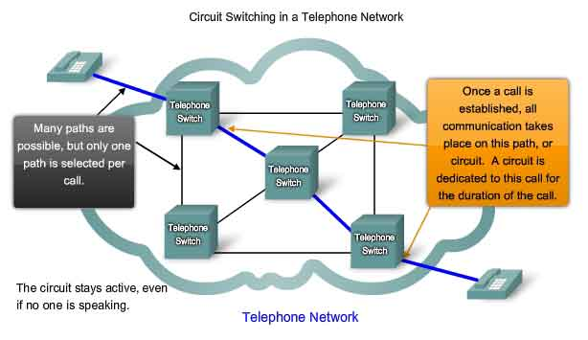
Circuit Switching in a Network
economy of circuits ✘
resilience / survivability -
latency ✓
... a waste of resources when there is no data to transmit
http://www.highteck.net/EN/Basic/Internetworking.html

Slide 8
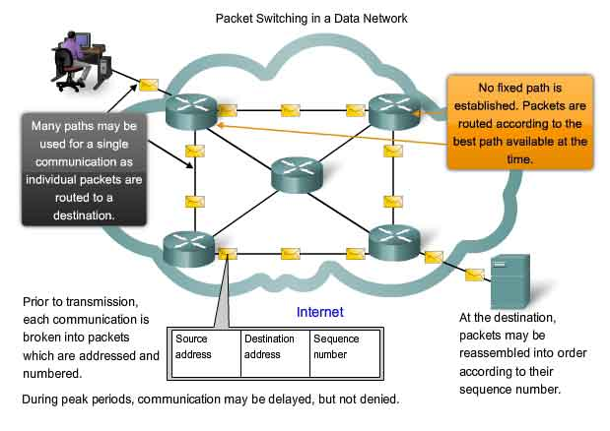
Packet Switching in a Network
economy of circuits ✓
resilience / survivability ✓
latency ✘
http://www.highteck.net/EN/Basic/Internetworking.html

Slide 9
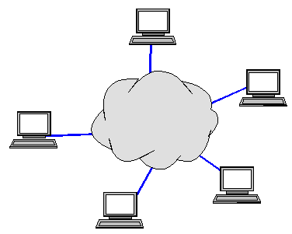

Packet Switching
digitised voice
010100101
010100101
01001001
all traffic – voice, video, data is split into packets
packets are dropped into a bitstream as/when available
… “statistically multiplexed”
… the bitstream may not always have enough capacity for all the traffic competing for access
digital data
010100101
10010001
digital media
010100101
01001001
010100101
01001001
internet network link
010100101
010100101
01001001
010100101
10010001
010100101
01001001
010100101
01001001
address field - packets routed through network
House / business ethernet (or wireless) LAN

Slide 10
Message in Packets
start of frame
end of frame
Flag
Address
Control
Information Field (Payload)
CRC
Flag
00010100010101000101101010001001011100010010001100100001000110010011000100100111000111001001

Slide 11
Layers of Networks
The Carrier Network
Ethernet (Data Link)
Internet
(+ The Web)
Protocols
Routing

Slide 12

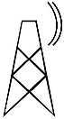
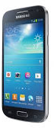
Telecomm Network
Internet Protocol – IP - to carry data, voice and media over telephone networks
Subscribers
Main Switching Centres
Local Exchanges

Slide 13

Telephone Network – Internet Overlay
ISP equipment (Internet Service Provider)
Many ISP’s:
calls routed across telephone network to ISPs’ servers
ISP

Slide 14
Layers of Networks
Services – from servers to clients – data, media, voice
Services – from servers to clients – data, media, voice
World Wide Web
World Wide Web
Internet
Internet
Telephone Network - BT
Telephone Network – France Telecom
other Telephone Networks … etc
Telephone Network
Internet
US, mid ’60’s ARPANET; DOD Universities
data (voice, video, data) is sent in packets
packets are routed around the network individually
“survivable network”

Slide 15
MPEG Systems
MPEG family
Overviews
MPEG-1, MPEG-2, MPEG-2 Audio, MPEG4
Audio Compression
Compression Usability, Latency
Encoding Architecture
Perceptual Coding: Psychoacoustic Models
Transform Domain Methods, Decoding
Coding, Bit Allocation, Frames
AAC - Advanced Audio Coding
MPEG-4 AAC, Low Delay Coder, Error Resilience,
AAC compared to mp3
Other Formats
Variable Bit Rate

Slide 16
MPEG
Motion Picture Experts Group
MPEG 1
audio and video coding - parts 1, 2, 3 (layers 1, 2, 3), 4, 5,
MPEG 2
audio and video coding - parts 1, 2, 3 (layers 1, 2, 3), …
MPEG 3 - originally for HDTV - abandoned
MPEG 4
audio and video coding - parts 1 - 22
MPEG 7
metadata, description
MPEG 21
framework for multimedia content delivery
XML-based; to communicate machine-readable license information
open framework for multimedia applications
"Rights Expression Language"

Slide 17
MPEG-1
Audio and video coding
Parts
1 - Synchronization and multiplexing of video and audio
- transport stream
2 - Compression codec for non-interlaced video signals
3 - Compression codec for perceptual coding of audio signals
- three layers of audio coding options (mp, mp2, mp3)
4 - Procedures for testing conformance
5 - Reference software
video CD format - quality ~ VCR
originally 1.5M bit/second data rates and 352x240 resolution
later up to 4M bit/second
the most compatible format in the MPEG family
only progressive scan video (... so need for MPEG-2)

Slide 18
MPEG-2
(1994) Audio and video coding
for broadcast - DVB (satellite, cable, DTT, etc), also DVD (with mofifications)
9 Parts, including -
1 - Transport Streams - TS
to carry digital video and audio in (unreliable) broadcast applications
Program streams carry audio and/or video data + time stamp data
2 - Video
similar to MPEG-1
support for interlaced video
optimised > 3 Mbit/s; not for low bit-rates (less than 1 Mbit/s)
backwards compatible to MPEG1
enhancements - used (to date) in most HDTV transmission systems
3 - Audio
layers 1, 2, 3
4, 5 - as MPEG-1
7 - Enhanced audio

Slide 19
MPEG-2 Audio
Part 3
new audio encoding (see later...)
low bitrate encoding with halved sampling rate
MPEG-1 Layer 1/2/3 LSF - low sampling frequency
multichannel encoding with up to 5.1 channels
... backwards compatible -
MPEG-1 audio decoders can decode stereo from MPEG-2 multi-chan audio
MPEG-2 AAC - Part 7
make better use of available bandwidth
non-backwards-compatible

Slide 20
MPEG Systems
Data
MPEG-2 Transport Mux
MPEG-2
Compressors
Video
Audio
Video
Audio
Transport Stream, TS
Decoder
MPEG-2
Systems Processor
MPEG-2
Systems Processor
Decoder
Program Stream, PS
Decoder
Requirement:
To transmit Audio and Video compressed data in:
(i) reliable channels – studio, DVD, reliable media (PS)
(ii) transmission in hostile environments (TS)
Allow interchange between these two formats

Slide 21
Transport Stream Multiplex
Transport Steam: Composed of A number of Program Streams (and their Elementary Streams)
when MPEG-2 content is to be distributed / networked, Transport streams are the structure
they are a multiplex of PESs
i.e. carry a number of programmes
MPEG-2Transport Stream
A
A
A
A
D
D
D
D
V
V
V
V
Multiplex
V
V
V
A
V
D
SI
V
V
SI
SI
SI
SI
etc
etc
etc
etc
SI = Service Information
Transport Stream Multiplex consists entirely of short, fixed length transport packets
188 Bytes
Packet Header
Adaption Field
Payload
FEC
4 Bytes

Slide 22
Transport Stream Multiplex
Elementary Streams
MPEG-2
Multiplexer
Output - a contiguous stream of 8-bit-wide data bytes
e.g. a Freeview Multiplex of ~ 6 TV channels and some radio channels
Elementary Streams
Elementary Streams
Elementary Streams
Service Information
Synchronisation
Channel Adapter
& Modulation
Conditional Access
Private Data
Data rate
No constraints, but must at least equal the total of the combined data rates of the contributing elementary streams
Fixed or variable data rate; may contain fixed or variable data rate elementary streams
Not specified:
error protection, modulation technique, physical layer technologies
Time stamping system
to ensure that related elementary streams are replayed in synchronism at a decoder
Tables of service information
network parameters, programmes within the multiplex and the nature of the various elementary streams
Conditional Access
Allow control of scrambling of one or more elementary streams (but CA not specified by MPEG)
Private Data
i.e. not spec’d by MPEG - include network management data, teletext, etc

Slide 23
MPEG-2 Packets and Multiplexes
audio and video data can be exchanged between TS and PS at PES level
Access Units (AU)
Audio Elementary Stream
Audio Presentation Units: 24mS of Raw uncompressed audio
Audio PES
Audio
Encoder
TS Multiplexer
Transport Stream
(TS)
Packetiser
Clock
Video
Encoder
Packetiser
PS Multiplexer
Program Stream
(PS)
Video Presentation Units: Raw video coding at discrete time intervals
Video PES
Scope of MPEG-2 Systems Standard
Access Units (AU)
Video Elementary Stream

Slide 24
Video Elementary Stream
Video Presentation Unit
625 lines
4:2:2
=830KB
Uncompressed Digital Video Stream
Picture 830KB
Picture 830KB
Picture 830KB
Picture 830KB
Compression: Raw → DCT → I, P, B
Compressed
I-Picture
~100KB
Compressed
B-Picture
~ 12KB
Compressed
B-Picture
~ 12KB
Compressed
P-Picture
~ 33KB
Access Units
Video Elementary Stream - figures for SD video and compression of approx 5Mb/s

Slide 25
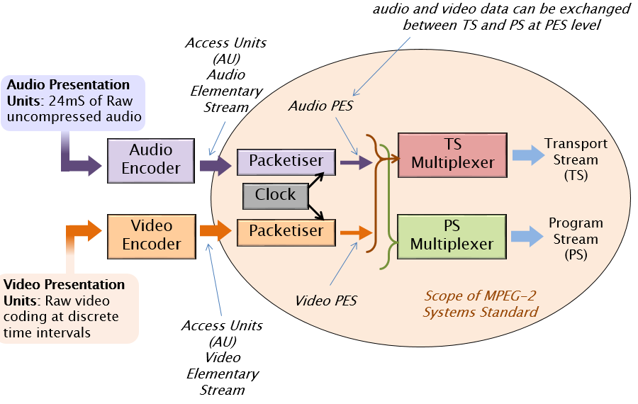
Packetizing
Elementary Stream - ES - sub-divided – packetised
⇒"Packetized Elementary Stream“ = PES
fixed-size chunks without regard for access unit boundaries
TS: TS packets, 188B
PS: Many packets Form PS Packs

Slide 26
MPEG-2 – PES ⇒ PS Packs and TS Packets
PS
Pack
Pack
........................
Pack
Pack
Program end code
Pack
Pack
Header
PES
PES
...................
PES
PES
PES
PES
Header
PES payload
TS
Packet
TS
Header
TS payload
TS
Header
TS payload
TS
TS Packet
PID =m
TS Packet
PID = k
TS Packet
PID = m
.................................
TS Packet
PID = h
TS Packet
PID = k
188 bytes
188 bytes
188 bytes
188 bytes
188 bytes

Slide 27
MPEG-2 - Packet Multiplexing, Video, Audio, Data Streams
Packets multiplexed
efficient and flexible
allows for conversion PS ↔ TS
Transport Stream – TS
for channels with likely errors
short fixed-length: 188B
PES packets – long variable length
Sub-divided
carried as payload of TS packets
Program Steam - PS
for transmission and storage in error-free channels
PES - long variable-length packets
... into variable length packs
multiple PES packets
... of nearly equal length
(video and audio)
PS
Pack
Pack
........................
Pack
Program end code
Pack
Pack
Header
PES
PES
...................
PES
PES
PES
PES
Header
PES payload
TS
Packet
TS
Header
TS payload
TS
Header
TS payload
TS
TS Packet
PID =m
TS Packet
PID = k
TS Packet
PID = m
.................................
TS Packet
PID = h
TS Packet
PID = k
188 bytes
188 bytes
188 bytes
188 bytes
188 bytes

Slide 28
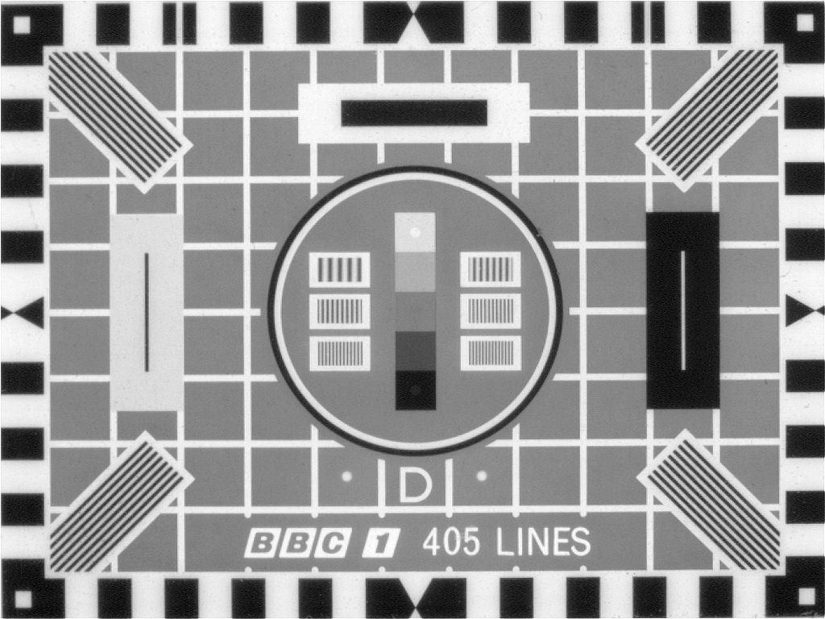

Slide 29

DVB - Digital Video Broadcasting
Standards
Satellite DVB-S, DVB-S2, SH
Cable DVB-C, DVB-C2
DTT DVB-T, DVB-T2
DTT for handhelds DVB-H, DVB-H2
IPTV DVB-IPTV
DASH DVB-DASH
DVB-3DTV - Frame Compatible Plano-Stereoscopic 3DTV
DVB-C2 - 2nd Generation Cable Transmission
DVB-CID - Carrier Identification for Satellite Transmission
DVB-CPCM - Content Protection and Copy Management
DVB-FF - DVB File Format
DVB-GEM - Globally Executable MHP
DVB-GSE - Generic Stream Encapsulation
DVB-H - Broadcasting to Handheld Devices
DVB-IPDC - Internet Protocol Datacasting
DVB-IPTV - Internet Protocol Television
DVB-MHP - Open Middleware for Interactive TV
DVB-PCF - Portable Content Format
DVB-RCS2 - Return Channel Satellite
DVB-RCT - Return Channel Terrestrial (03/2001)
DVB-S2 - 2nd Generation Satellite Broadcasting
DVB-SH - Satellite Services to Handheld Devices
DVB-T - Digital Terrestrial Television
DVB-T2 - 2nd Generation Terrestrial Broadcasting
DVB - Emergency Warning System
DVB Project - An Introduction
Hierarchical Modulation in DVB-T (03/2000)
plus many others (inc addenda, etc) …
Industry Organisation
Standardisation Process –
Joint Technical Committee (JTC) of:
ETSI - European Telecommunications Standards Institute
CENELEC - European Committee for Electrotechnical Standardization CENELEC
EBU - European Broadcasting Union
Note standards refer to other standards and patents, e.g. MPEG
http://www.dvb.org/standards/factsheets

Slide 30
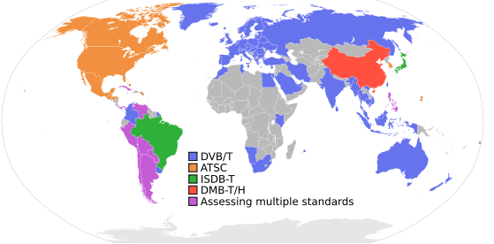
Digital Terrestrial TV (DTT)
Digital Video Broadcast, Terrestrial Television - DVB-T
Europe; also DVB-S for Satellite, DVB-C for Cable; DVB-H for handhelds
MPEG2 format; also
Integrated Services Digital Broadcasting, Television - ISDB-T
Japan; also ISDB-S for Satellite, ISDB-C for CableTV
MPEG2 format
Modulation: PSK, COFDM/PSK/QAM
Advanced Television Systems Committee - ATSC-8VSB
Modulation: 8VSB: 8-level Vestigial Sideband
American Continent
MPEG2-TS

Slide 31
DVB Specifies …
Specifies - essentially a layer one protocol for transport with Data Link (Transport Streams, GSE, etc)
Including -
Input Interface
usually Transport Streams - i.e. TV
Generic Stream Encapsulation – e.g. IP
Modes
Variable Coding and Modulation
Adaptive Coding and Modulation
FEC
e.g. DVB-T2: LDCP, BCH ½. 3/5. 2/3. ¾. 4/5. 5/6
Modulation
e.g. DVB-T2: OFDM
Modulation Schemes
Q/8/16/32PSK, QAM
e.g. DVB-C2: 16-4096QAM
Guard Interval
e.g. DVB-T2: 1/4, 19/256, 1/8, 19/128, 1/16, 1/32, 1/128 (fractions of a symbol)
Interleaving
Bit- Time- and Frequency-Interleaving

Slide 32
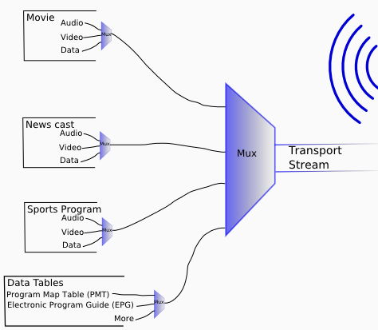
Transport Stream Multiplex
Transmission:
Terrestrial
Cable
Satellite
Broadband
Program Streams

Slide 33
MPEG
Motion Picture Experts Group
MPEG 1
audio and video coding - parts 1, 2, 3 (layers 1, 2, 3), 4, 5,
MPEG 2
audio and video coding - parts 1, 2, 3 (layers 1, 2, 3), …
MPEG 3 - originally for HDTV - abandoned
MPEG 4
audio and video coding - parts 1 - 22
MPEG 7
metadata, description
MPEG 21
framework for multimedia content delivery
XML-based; to communicate machine-readable license information
open framework for multimedia applications
"Rights Expression Language"

Slide 34
Compression
- Introduction

Slide 35
Why Compress Video
Size of uncompressed 1080p HDTV
1920 * 1080 ≈ 2 Mpixels per frame
For RGB this is 6MB per frame
Thus 1 second of video needs
25 *6MB = 150MB
Data rate of 150 *8 = 1200 Mbps = 1.2 Gbps
One hour of video needs 3600*150 MB
= 540,000 MB = 540 GB

Slide 36
Why Compress Audio?
CD quality = 2* 44.1 *16 Kbps ≈ 1.4 Mbps
About 1/850 of HDTV video
1 hour of audio needs 3600* 1.4 /8 = 630 MB
100 tracks take about 360 minutes ≈ 4 GB

Slide 37
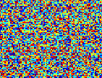
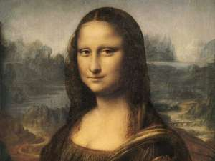
Compression – Information Theory
IF …
image is all the same colour
very easy to compress - just replace with colour value and codeword to indicate
every pixel is a random number between 0 & 255 and not correlated in any way with other pixels
it is impossible to compress
In between -
look for patterns only for lossless compression
additionally psychovisual characteristics for lossy compression

Slide 38
Compressed and Uncompressed Images
raster
image
processing
time
display
compressed
image
display
processing
time

Slide 39
Lossless Compression (of Images)
Three standard techniques that take advantage of regular and repeating data
Run Length Encoding (RLE)
Huffman Compression
Differential (or Predictive) Coding
ironically in their pure form they are most suited to compression of bitmap representations of computer generated images

Slide 40
Lossless Compression
RLE replaces repeating bytes with number and kind:
e.g.777555555 becomes 3765
compression ratio 9:4 =2.25
In most applications RLE files are further compressed using Huffman which scans the whole file to discover the most frequently occurring bytes. These bytes are then translated to bit form, for example using only 1 bit for the most frequently occurring byte , 2 bits for the next most frequently occurring and so on

Slide 41
Bit Rate Reduction Principles
Main process of bit-rate reduction:
Remove lower priority information from the signal at encoder
... according to what we perceive in the image
Coding - including information about the bit-rate reduction
... codec at time of image capture
Decode - to assemble and play the compressed file
... codec at time of viewing image

Slide 42
Audio Compression (Introduction)

Slide 43
Audio Compression
Audio Compression
Compression Usability, Latency
Encoding Architecture
Perceptual Coding: Psychoacoustic Models
Transform Domain Methods, Decoding
Coding, Bit Allocation, Frames
AAC - Advanced Audio Coding
MPEG-4 AAC, Low Delay Coder, Error Resilience,
Variable Bit Rate

Slide 44
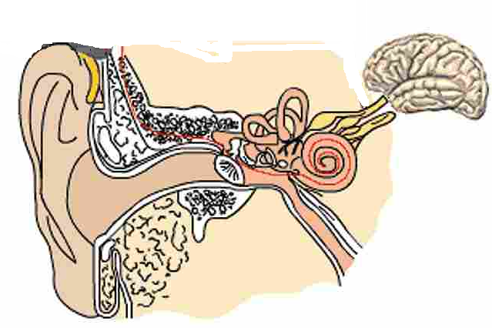
The Physiology of Hearing
Auditory Canal
acts as a closed tube resonator
enhances sounds in the range 2-5 KHz
Auditory Nerve
Ossicles
Cochlea
low + high frequencies
Stirrup
Tympanic Membrane
Pinna
presents larger area to received sound energy
“collects” sound – like a preamplifier

Slide 45
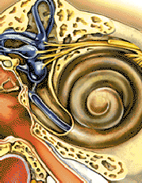
The Physiology of Hearing – The Cochlea
High frequency sounds
schematic view - unroll the cochlea - distribution of sensitive hair cells
Lower frequencies
hair cells
incoming sounds
nerve endings

Slide 46
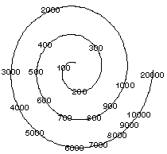
The Physiology of Hearing – The Cochlea
http://www.hitl.washington.edu/publications/hollander/2.html
low + high frequencies

Slide 47
The Physiology of Hearing
freq
critical band
freq
Two signals within a critical band - closely related in frequency
stimulate the same area of the membrane in the cochlea
these two sounds added together don’t give twice the loudness
critical band
critical bands
freq
Two signals - frequencies separated
stimulate the different areas of the membrane in the cochlea
not competing for the same nerve endings
give an appreciable increase of perceived intensity

Slide 48
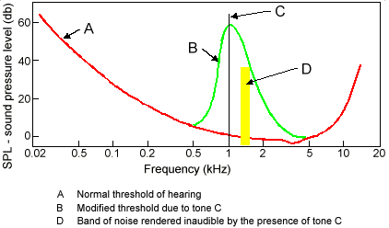
Threshold of Hearing, Masking Threshold

Slide 49
MPEG Psychoacoustic Models
MPEG standard defines two models:
Psychoacoustic Model 1:
simpler, less computationally expensive
serious compromises in what it assumes a listener cannot hear
Psychoacoustic Model 2:
More features
more complex coding (assuming increased processor bandwidth)
Layer III (.mp3)

Slide 50
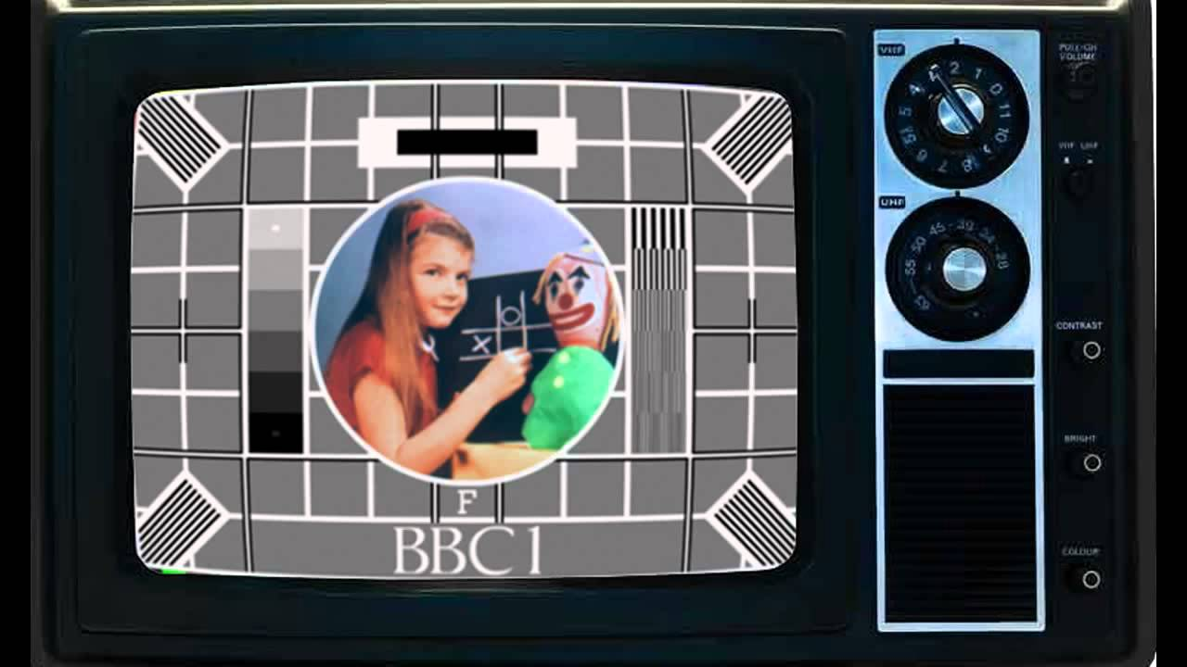
Video Compression (Introduction)

Slide 51

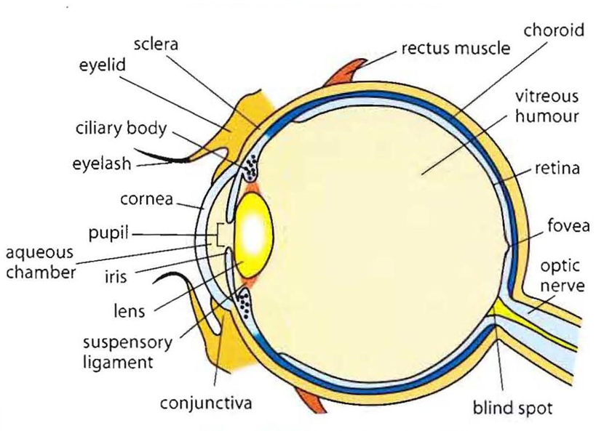
The Eye
The Eye
The Eye

Slide 52
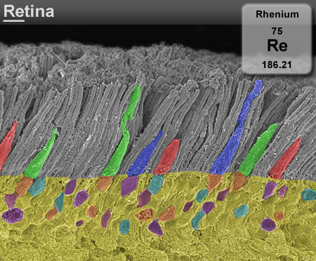
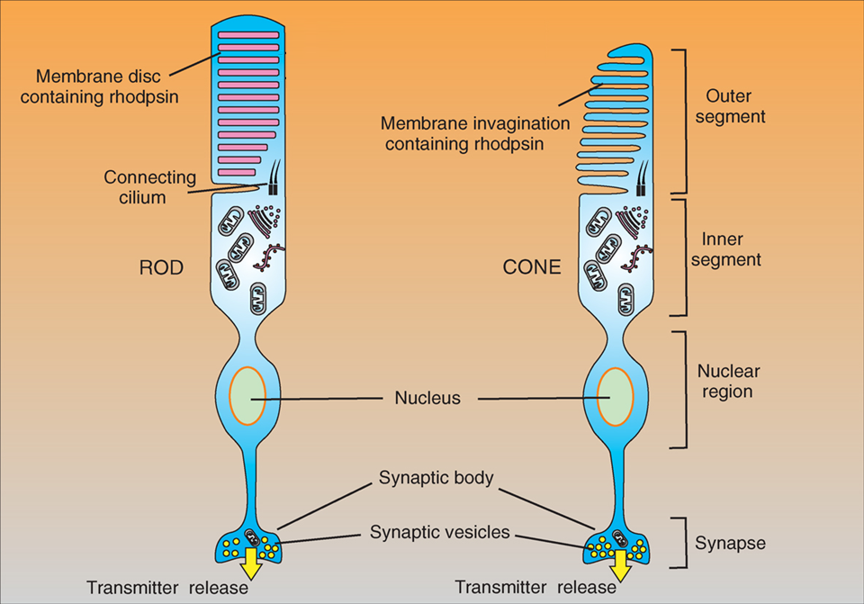
Receptors
… Rods and Cones
http://www.cellsignallingbiology.org/csb/010/csb010fig10_rod_and_cone_structure.htm

Slide 53
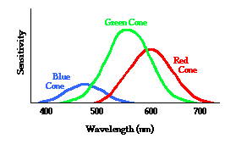
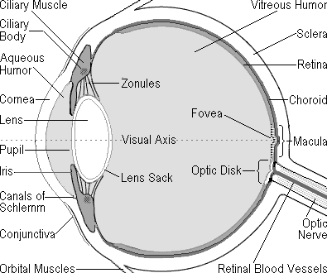
Psychovisual – how we perceive images
Light sensitivity in the eye
Rods - light intensity - not colour
~125 million across the retina
characteristics of high speed black & white film
Cones - colour - responsive in three wavebands
6 or 7 million cones
characteristics of low-speed colour film
RODS and CONES
(retina)
... Chroma Sub-sampling

Slide 54
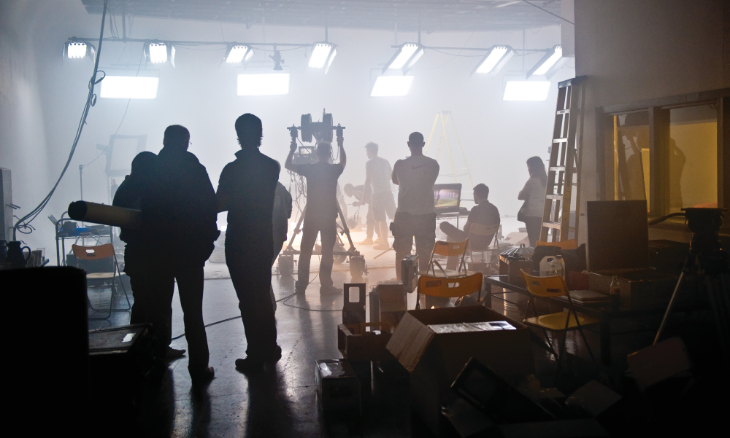
Images Captured on a Camera
Original captured image at camera sensor:
Image captured on red blue and green – responsive photo-sites
each pixel is represented by R, B, G
each pixel has its own value of light intensity

Slide 55
RGB to Y,Cb,Cr
Y
During the encoding stage ...
Cb
RGB pixel format … … … is converted to … … … Y,Cb,Cr
where
Y = luminance (light intensity)
Cb, Cr = colour information
Cr
Weighted RGB converted to Y Cb, Cr
0.2989*R + 0.5870*G + 0.1140*B

Slide 56

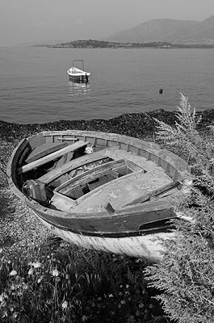
RGB to Y,Cb,Cr – each pixel
Overall luminance
i.e. greyscale, monochrome
of this pixel
= Y, ... i.e. the luma
Weighted RGB luminance:
approx 29% Red + 59% Green + 11% Blue

Slide 57
RGB to Y,Cb,Cr – each pixel
Cb = B – Y
i.e. 8 bits of Cb (0-255)
value of Cb:
value of original Blue
minus
value of luma
= -
e.g.
= 210 - 90
1111000
11010010
similarly,
Cr = R – Y
= -
01011010
Overall luminance
i.e. greyscale, monochrome
of this pixel
= Y, ... i.e. the luma
Weighted RGB luminance:
approx 29% Red + 59% Green + 11% Blue

Slide 58
Y,Cb,Cr – for image of x x y pixels in “4:4:4”
y pixels
x pixels

Slide 59
Y,Cb,Cr – Chroma Sub-sampled to “4:1:1”
y pixels
Reason: To greatly reduce the amount of data
Rationale: The eye’s resolution of luminance is greater than for colour
x pixels

Slide 60

Y,Cb,Cr
Original image
YCbCr
Colour Space: Y = Luminence Information; Cr, Cb = Chrominance Information
Derived from RGB (gamma corrected)
Y is dominant information; RGB colour info derived from Y, Cr, Cb relationships
(simplified): Cb = B-Y ; Cr = R-Y
Y
Cb
Cr

Slide 61




RGB to Y,Cr,Cb
i.e. there are now three mappings of the original RGB image:
Y: Luminance intensity
Cb: Intensity of the values of
[B minus Y]
Cr: Intensity of the values of
[R minus Y]
Y
Y
Cb
Cb
Cr
Cr

Slide 62
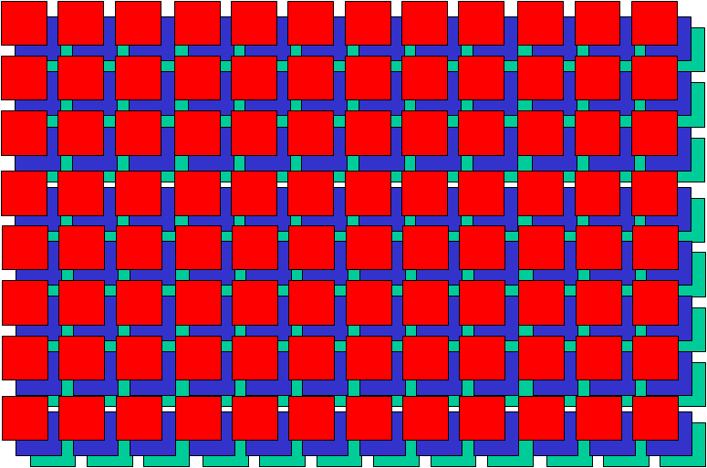
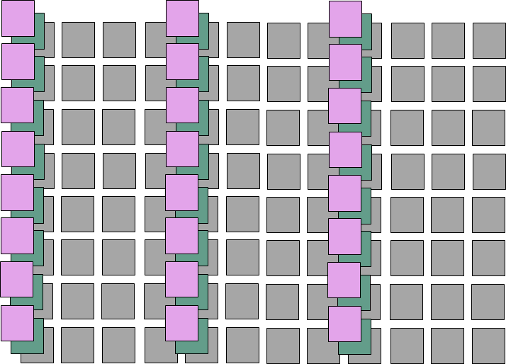

Reception / Decoding
encoding process
decoding process
Decoding, reverse process ...
from Chroma sub-sampled to full RGB
note – interpolating lost information
∴ detail is lost in the process
Perceptual (e.g. MPEG, etc ) encoding + decoding is also part of this process and loses a lot more detail
... more later in the module

Slide 63
MPEG –
Coding For
Moving Images
Intraframe and Interframe Compression

Slide 64
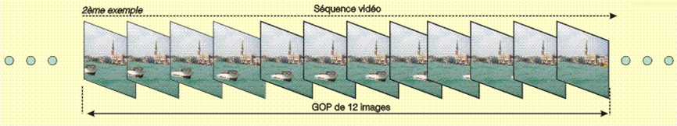
GOPs – Groups Of Pictures
Video Sequence
Group Of Pictures (GOP)
Group of Pictures (GOP)
Header + series of one of more pictures
3 types of pictures: I, P, B
Provides a regular structure of video content
recurring pattern of pictures
allow easy access to the video stream
For TV the GOP is 12 pictures ( 0.5 s of a projected at 24 frames / s movie
For NTSC 30 fps, uses 15 pictures

Slide 65
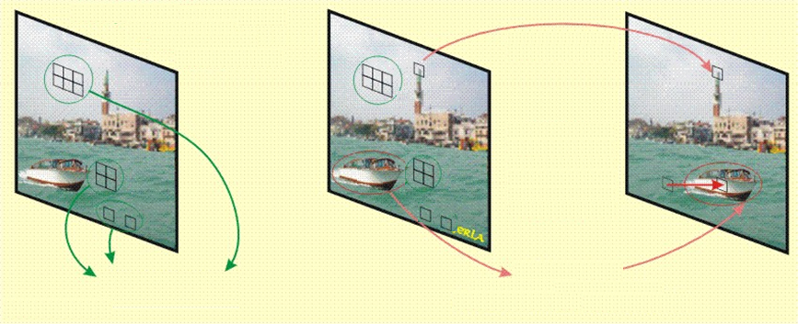

Basic Principles for Moving Elements in Images
Blocks Identical or nearly-identical in following frames
Blocks with nearly* identical characteristics are replicated; spatial displacement is coded with a motion vector
*we’ll deal with the “nearly” part shortly …

Slide 66
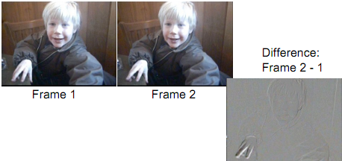
Difference Coding
Amount of information in the difference between the two frames is a lot less than in Frame 2
motion in the scene will increase the differences
analyse motion
… where each block moved since previous frame
encode motion as vector -
x- and y- direction vectors
encode differences for the moved block like a jpg,
i.e. DCT, quantization, RLE (zig-zag), Huffman
(… but this jpeg is very simple to encode due to little changed information in the image)
see - http://www.cs.ucl.ac.uk/teaching/GZ05/08-h261.pdf

Slide 67
Codecs –
Current, Emerging: Tensions in the Market

Slide 68
Codecs – Current, Emerging, Tensions in the Market
New formats - AV1, VVC, EVC, and NDI
Rising video consumption
more immersive higher resolution TV
major new family of video compression standards from
MPEG + ITU-T Study Group 16’s VCEG
(Video Coding Experts Group)
Undermining of MPEG HEVC by some of its own patent holders
⇨ traditional codecs versus potentially disruptive alternatives
Cost for distributing video is a major factor
- especially in IP nets (the quality is compressed)

Slide 69
Codecs – Current, Emerging, Tensions in the Market
Current market
AVC/H.264 codec
old, popular, widespread decoder support, well-functioning licensing situation
HEVC - adoption low in streaming …
HEVC Advance (licensing admin)
licensing cost issues
slow take-up in key market segments
⇨ Rival codecs - better performance / royalty free / or both
Patent holders had technology accepted before declaring rights and costs in the patent pools
further fragmented by HEVC IP holders

Slide 70
Codecs – Current, Emerging, Tensions in the Market
The “Tax on distribution”
MPEG LA - charges per decoding units capped at U$25m a year
HEVC Advance caps annual unit charge at U$40m
demands royalties for streaming, capped at U$5m a year
other HEVC IP owners - Nokia and Technicolor late to join a pool or announce royalty policy
HEVC royalties significantly more expensive than H.264

Slide 71
Codecs – Current, Emerging, Tensions in the Market
Emerging … AV1
Royalty-free (but not yet contested in court … )
Based on VP9
Alliance for Open Media (AOMedia) (BBC R&D is a member)
Few well-conducted comparisons between AV1 <> HEVC
HEVC supporters say HEVC is 30% better than AV1
AV1 supporters say AV1 is 40% better than HEVC
(see later in these slides …)
AV1 - significantly more complex encoder to achieve performance
... so not good for real time

Slide 72
Codecs – Current, Emerging, Tensions in the Market
Joint Video Exploration Team (JVET) – VVC
Versatile Video Coding (VVC)
MPEG – collaborate with ISO and ITU-VCEG (Video Coding Experts Group):
formed JVET
new suite of video coding technologies
basing its work on HEVC
BBC R&D (Marta Mrak):
“HEVC and AV1 are similar; VCC 30% better”
UHD bitrates similar to current HDTV; storage: 2x as much

Slide 73
Codecs – Current, Emerging, Tensions in the Market
Bitmovin - AV1 will be standard for future content - hi res, VR and AR
Others say - new codec needed
data demands of 5G - ultra-high bandwidth low latency streaming - VR, 8K - need a new codec - AV1 is not designed for that

Slide 74
Codecs – Current, Emerging, Tensions in the Market
EVC - Essential Video Coding
MPEG-5
Extensible from Royalty free basic profiles
to
licensed more complex profiles
also …
NewTek
NDI – Royalty Free s/w standard for video device intercommunication
ND1- Codec - Low latency, ~4:1 UHD

Slide 75
Streaming
HTTP, HLS
MPEG-DASH
RTP/RTSP

Slide 76
HTTP Streaming
The original solution for streaming
... overtaken by RTP/RTSP based for large IPTV deployments
... more recently back in favour
used generic HTTP servers (often based on Apache or Windows Server)
Early days
Limited bandwidth available
“Download and play”
no lookahead seeking or random access
Multiple viewers – server bandwidth issues
Apple introduce progressive download

Slide 77
Streaming Media Protocols – HTTP addresses RTMP Issues
HTTP server/client – stateless
HTTP-streaming: retrieves consecutive short chunks on as-needed basis
little waste (the video is delivered as it is watched)
server efficiently serves more streams
Random seeking
(viewer selects – player retrieves the appropriate chunks)
firewall friendly
can utilise HTTP caching mechanisms
less expensive to implement (no streaming server required)
scale more cheaply and effectively to serve available users
RTMP/RTSP/HTTP – state of the market
little impetus for RTMP/RTSP sites to change –still widely used
new installations - overwhelming view – HTTP
in fact most video content is delivered via plain old HTTP progressive download

Slide 78
HTTP Streaming
Segment timing:
10 seconds = reasonable balance for most broadcast content
Shorter segments
= more frequent refreshes of the index file
.. unnecessary network overhead for the client
Longer segments
= latency and initial startup time
Media Formats
e.g. video: H.264 / VP9,
audio: .aac / Opus, etc
video + audio file segments unwrapped
… but certain applications –
can be wrapped in MPEG-TS (DVB)
Client
Server
http GET
Audio segment
http GET
Video segment
etc

Slide 79
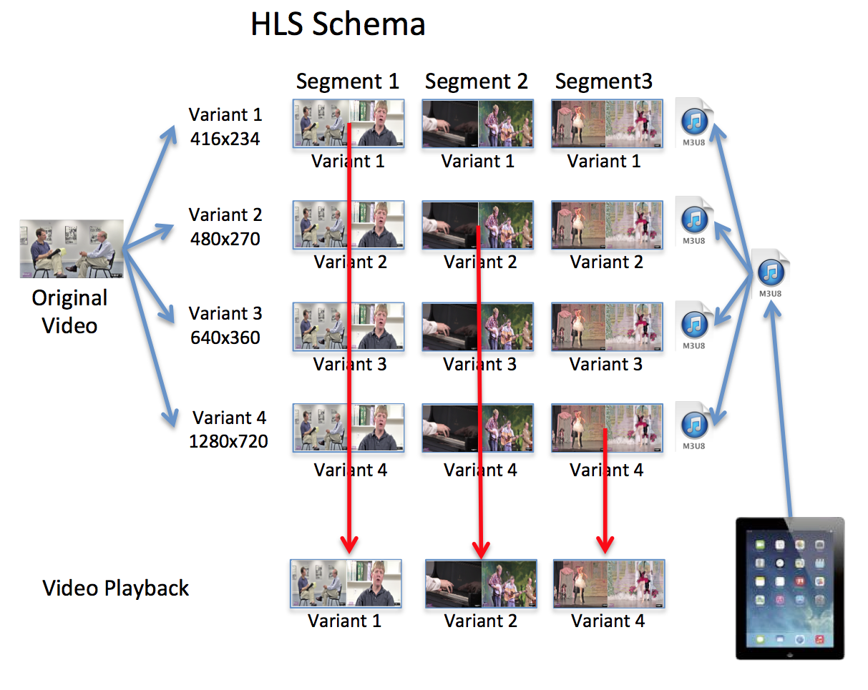
HTTP Live Streaming - HLS
Apple (part of QuickTime and iOS)
HLS v5 announced in Sept16
support for Fragmented MP4

Slide 80

MPEG-DASH
Dynamic Adaptive Streaming over HTTP
Background
(commercial) audio/video was typically transported over RTP/UDP
(but streaming proprietary solutions based HTTP/TCP)
HTTP streaming - good - provided that the increased latency is acceptable
Benefits:
Firewall and NAT traversal (c.f. services based on RTP/UDP)
Widely deployed network caches (CDNs)
Deployment of CDN caches can be kept simple
Complexity (adaptation) moved to client
Servers are agnostic to delivered content
network resources / configuration may vary over time
http://www.streamingmedia.com/Articles/ReadArticle.aspx?ArticleID=79041

Slide 81
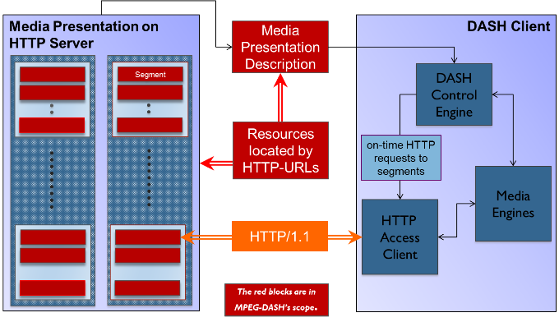
MPEG-DASH
DASH client obtains the MPD …
MPD (Media Presentation Description) –
XML document
delivered using HTTP or other transport
describes media data available at the servers
allows clients to select the data
defines segments available
can either be
initialization segments - initialization data for decoding
media segments
segment format based on MPEG2-TS
Using ISO base Media File Format (ISOBMFF - general structure for time-based media
(however, segments based on other formats can be specified)

Slide 82
